Slide 1

LINQ Operators
Module 4.2

Slide 2
Agenda
Expression and Method-based syntax
LINQ Operators

Slide 3
Expression syntax vs Method-based syntax
var query = from word in words group word.ToUpper() by word.Length into gr orderby gr.Key select new { Length = gr.Key, Words = gr };
Expression syntax
var query = words. GroupBy(w => w.Length, w => w.ToUpper()). Select(g => new { Length = g.Key, Words = g }). OrderBy(o => o.Length);
Method-based syntax
Query Expression Syntax for Standard Query Operators

Slide 4

Expression syntax VS Method-based syntax
return A
.Where(x => x > 2)
.Select(x => x + 1);
return ((IEnumerable<int>) A)
.Where<int>((Func<int, bool>) (x => x > 2))
.Select<int, int>((Func<int, int>) (x => x + 1));
return from x in A where x > 2 select x + 1;

Slide 5
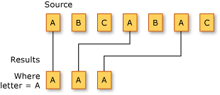
Restriction Operators
Method | C# Expression Syntax | VB Expression Syntax
OfType() | - | -
Where() | where | Where
Filtering Data
LINQ - Restriction Operators

Slide 6
Restriction Operators. Samples
int[] numbers = { 5, 4, 1, 3, 9, 8, 6, 7, 2, 0 }; var lowNums = from num in numbers where num < 5 select num;
var expensiveInStockProducts = from prod in products where prod.UnitsInStock > 0 && prod.UnitPrice > 3.00M select prod;
string[] digits = { "zero", "one", "two", "three", "four", "five", "six", "seven", "eight", "nine" }; var shortDigits = digits.Where((digit, index) => digit.Length < index);

Slide 7
Projection Operators
Method | C# Expression Syntax | VB Expression Syntax
Select() | select | Select
SelectMany() | multiple from | multiple From
Projection Operations
LINQ - Projection Operators

Slide 8
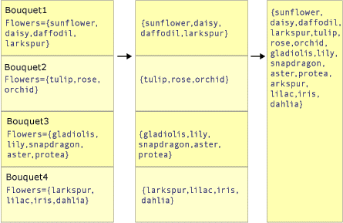
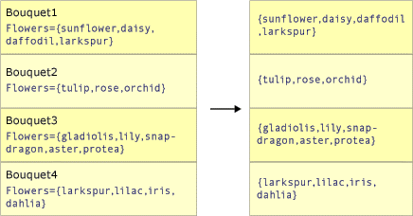
Select vs SelectMany
class Bouquet { public List<string> Flowers { get; set; } }
IEnumerable<string> query2 =
bouquets.SelectMany(bq => bq.Flowers);
IEnumerable<List<string>> query =
bouquets.Select(bq => bq.Flowers)

Slide 9
Select. Samples
var productNames = from prod in products select prod.ProductName;
var productInfos = from prod in products select new {prod.ProductName, prod.Category, Price = prod.UnitPrice};
int[] numbers = { 5, 4, 1, 3, 9, 8, 6, 7, 2, 0 }; var numsInPlace = numbers.Select((num, index) => new {Num = num, InPlace = (num == index)});

Slide 10
SelectMany. Samples
int[] numbersA = { 0, 2, 4, 5, 6, 8, 9 }; int[] numbersB = { 1, 3, 5, 7, 8 }; var pairs = from a in numbersA from b in numbersB where a < b select new {a, b};
var orders = from cust in customers where cust.Region == "WA" from order in cust.Orders where order.OrderDate >= cutoffDate select new {cust.CustomerID, order.OrderID};
var orders = from cust in customers from order in cust.Orders where order.Total < 500.00M select new {cust.CustomerID, order.OrderID, order.Total};

Slide 11
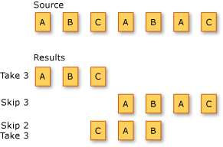
Partitioning Operators
Method | C# Expression Syntax | VB Expression Syntax
Skip() | - | Skip
SkipWhile() | - | Skip While
Take() | - | Take
TakeWhile() | - | Take While
Partitioning Data
LINQ - Partitioning Operators

Slide 12
Partitioning Operators. Samples
var first3WAOrders = ( from cust in customers from order in cust.Orders where cust.Region == "WA" select new {cust.CustomerID, order.OrderID, order.OrderDate} ) .Take(3);
var waOrders = from cust in customers from order in cust.Orders where cust.Region == "WA" select new {cust.CustomerID, order.OrderID, order.OrderDate}; var allButFirst2Orders = waOrders.Skip(2);
int[] numbers = { 5, 4, 1, 3, 9, 8, 6, 7, 2, 0 }; var firstNumbersLessThan6 = numbers.TakeWhile(n => n < 6);

Slide 13
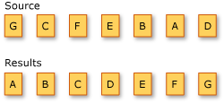
Ordering Operators
Method | C# Expression Syntax | VB Expression Syntax
OrderBy() | orderby | Order By
OrderByDescending() | orderby … descending | Order By … Descending
ThenBy() | orderby …, … | Order By …, …
ThenByDescending() | orderby …, … descending | Order By …, … Descending
Reverse() | - | -
Sorting Data
LINQ - Ordering Operators

Slide 14
Ordering Operators. Samples
string[] words = { "cherry", "apple", "blueberry" }; var sortedWords = from word in words orderby word.Length select word;
var sortedProducts = from prod in products orderby prod.Category, prod.UnitPrice descending select prod;
string[] words = { "aPPLE", "AbAcUs2", "AbAcUs1", "AbAcUs5",
"AbAcUs7", "bRaNcH5", "BlUeBeRrY", "ClOvEr", "cHeRry" }; var sortedWords = words.OrderBy(a => a.Length) .ThenByDescending(a => a.Substring(0, 5), new CaseInsensitiveComparer()) .ThenBy(a => a.Last());

Slide 15
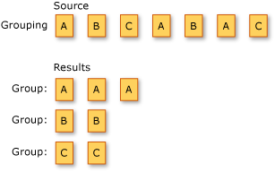
Grouping Operators
Method | C# Expression Syntax | VB Expression Syntax
GroupBy() | group … by group … by … into … | Group … By … Into …
ToLookup() | - | -
public interface IGrouping<out TKey, out TElement> : IEnumerable<TElement>, IEnumerable { TKey Key { get; } }
Grouping Data
LINQ - Grouping Operators

Slide 16
Grouping Operators. Samples
int[] numbers = { 5, 4, 1, 3, 9, 8, 6, 7, 2, 0 }; var numberGroups = from num in numbers group num by num % 5 into numGroup select new { Remainder = numGroup.Key, Numbers = numGroup };
var customerOrderGroups = from cust in customers select new { cust.CompanyName, YearGroups = from order in cust.Orders group order by order.OrderDate.Year into yearGroup select new { Year = yearGroup.Key, MonthGroups = from order in yearGroup group order by order.OrderDate.Month into MonthGroup select new { Month = MonthGroup.Key, Orders = MonthGroup } } };

Slide 17




Set Operators
Distinct
Except
Method | C# Expression Syntax | VB Expression Syntax
Distinct() | - | Distinct
Except() | - | -
Intersect() | - | -
Union() | - | -
Intersect
Union
Set Operations
LINQ - Set Operators

Slide 18
Set Operators. Samples
var categoryNames = ( from prod in products select prod.Category) .Distinct();
int[] numbersA = { 0, 2, 4, 5, 6, 8, 9 }; int[] numbersB = { 1, 3, 5, 7, 8 }; var uniqueNumbers = numbersA.Union(numbersB);
var productFirstChars = from prod in products select prod.ProductName[0]; var customerFirstChars = from cust in customers select cust.CompanyName[0]; var uniqueFirstChars = productFirstChars.Union(customerFirstChars);

Slide 19
Element Operators
Method | C# Expression Syntax | VB Expression Syntax
ElementAt() / ElementAtOrDefault() | - | -
First() / FirstOrDefault() | - | -
Last() / LastOrDefault() | - | -
Single() / SingleOrDefault() | - | -
Element Operations
LINQ - Element Operators

Slide 20
Element Operators. Samples
Product product12 = ( from prod in products where prod.ProductID == 12 select prod) .First();
string[] strings = { "zero", "one", "two", "three",
"four", "five", "six", "seven", "eight", "nine" }; string startsWithO = strings.First(s => s[0] == 'o');
Product product789 = products.FirstOrDefault(p => p.ProductID == 789);

Slide 21
Conversion Operators
Method | C# Expression Syntax | VB Expression Syntax
AsEnumerable() | - | -
AsQueryable() | - | -
Cast() | from .. in … | From … As …
ToArray() | - | -
ToDictionary() | - | -
ToList() | - | -
ToLookup() | - | -
OfType() | - | -
Converting Data Types
LINQ - Conversion Operators

Slide 22
Conversion Operators. Samples
var sortedDoubles = from d in doubles orderby d descending select d; var doublesArray = sortedDoubles.ToArray();
var scoreRecords = new[] { new {Name = "Alice", Score = 50}, new {Name = "Bob" , Score = 40}, new {Name = "Cathy", Score = 45} }; var scoreRecordsDict = scoreRecords.ToDictionary(sr => sr.Name);

Slide 23
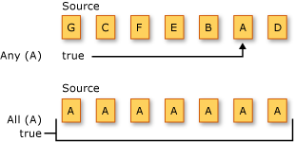
Quantifiers
Method | C# Expression Syntax | VB Expression Syntax
All() | - | Aggregate … In … Into All(…)
Any() | - | Aggregate … In … Into Any(…)
Contains() | - | -
Quantifier Operations
LINQ - Quantifiers

Slide 24
Quantifiers. Samples
string[] words = { "believe", "relief", "receipt", "field" }; bool iAfterE = words.Any(w => w.Contains("ei"));
var productGroups = from prod in products group prod by prod.Category into prodGroup where prodGroup.All(p => p.UnitsInStock > 0) select new { Category = prodGroup.Key, Products = prodGroup };

Slide 25
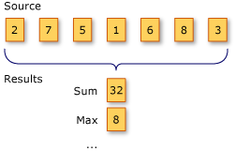
Aggregate Operators
Method | C# Expression Syntax | VB Expression Syntax
Aggregate() | - | -
Average() | - | Aggregate … In … Into Average()
Count() | - | Aggregate … In … Into Count()
LongCount() | - | Aggregate … In … Into LongCount()
Max() | - | Aggregate … In … Into Max()
Min() | - | Aggregate … In … Into Min()
Sum() | - | Aggregate … In … Into Sum()
Aggregation Operations
LINQ - Aggregate Operators

Slide 26
Aggregate Operators. Samples
int[] numbers = { 5, 4, 1, 3, 9, 8, 6, 7, 2, 0 }; int oddNumbers = numbers.Count(n => n % 2 == 1);
var categoryCounts = from prod in products group prod by prod.Category into prodGroup select new { Category = prodGroup.Key, ProductCount = prodGroup.Count() };
string[] words = { "cherry", "apple", "blueberry" }; int shortestWord = words.Min(w => w.Length);

Slide 27
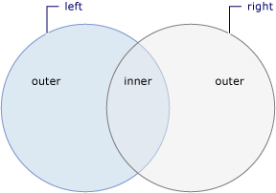
Join Operators
Method | C# Expression Syntax | VB Expression Syntax
Join() | join … in … on … equals … | From x In …, y In … Where x.a = y.a Join … [As …]In … On …
GroupJoin() | join … in … on … equals … into … | Group Join … In … On …
Join Operations
LINQ - Join Operators

Slide 28
Join Operators. Samples
var custSupJoin = from sup in suppliers join cust in customers on sup.Country equals cust.Country select new { Country = sup.Country, SupplierName = sup.SupplierName,
CustomerName = cust.CompanyName };
var custSupQuery = from sup in suppliers join cust in customers on sup.Country equals cust.Country into cs select new { Key = sup.Country, Items = cs };

Slide 29
Join Operators. Samples
var supplierCusts = from sup in suppliers join cust in customers on new { sup.City, sup.Country } equals new { cust.City, cust.Country } into cs from c in cs.DefaultIfEmpty() //Remove DefaultIfEmpty method call to make this an inner join orderby sup.SupplierName select new { Country = sup.Country, City = sup.City, SupplierName = sup.SupplierName, CompanyName = c == null ? "(No customers)" : c.CompanyName };

Slide 30
Additional materials
LINQ (Language-Integrated Query) (MSDN)
LINQ - Sample Queries (Code Samples)

